Slide 1
Ethyl acetate Hydrolysis
CH₃COOC₂H₅ + OH⁻ → CH₃COO⁻ + C₂H₅OH
A B
r = k C_{A} C_{B} with k = 7 l.mol⁻¹.min⁻¹
Solutions
C_{Aoo} = 0,1 mol.l⁻¹
C_{Boo} = 0,15 mol.l⁻¹
Batch reactor
V_{A} = 25 l
V_{B} = 20 l
CSTR & Plug flow
Q_{A} = 2,5 l.min⁻¹
Q_{B} = 2 l.min⁻¹
t_{Batch} = 11 min 47s
The proportions of ethyl acetate and soda introduced
in the batch reactor and in the continuous reactors
are the same
After dilution the initial concentrations are therefore
the same in the 3 reactors:
C_{Ao} = 0,056 mol.l⁻¹
C_{Bo} = 0,066 mol.l⁻¹
V_{CSTR} = 350 l
V_{PF} = 53 l
t_{Batch}? V_{CSTR}? V_{PF}?

Slide 2
Ethyl acetate Hydrolysis
CH₃COOC₂H₅ + OH⁻ → CH₃COO⁻ + C₂H₅OH
A B
C_{Aoo} = 0,1 mol.l⁻¹
C_{Boo} = 0,15 mol.l⁻¹
After dilution
C_{Ao} = 0,056 mol.l⁻¹
C_{Bo} = 0,066 mol.l⁻¹
Batch reactor
V_{A} = 25 l
V_{B} = 20 l
CSTR & Plug flow
Q_{A} = 2,5 l.min⁻¹
Q_{B} = 2 l.min⁻¹
r = k C_{A} C_{B} avec k = 7 l.mol⁻¹.min⁻¹
Indices
Indication 1: use the concentrations after mixing
Indication 2: for each reactor make a balance on ethyl acetate (A)
Indication 3: B consumption is equal to A consumption
Indication 4: for batch and plug flow reactors, integrate after a decomposition into simple elements (it is the same)

Slide 3
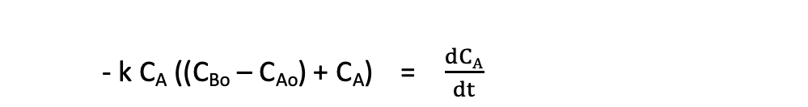
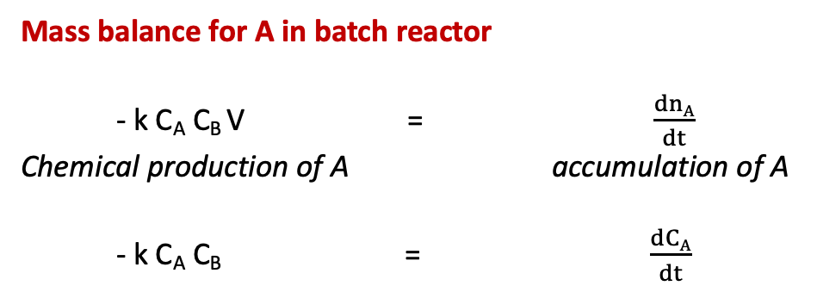
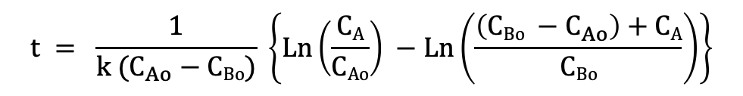
Ethyl acetate Hydrolysis
Mass balance for A in batch reactor
- k C_{A} C_{B} V = $\frac{dnA}{dt}$
Chemical production of A accumulation of A
- k C_{A} C_{B} = $\frac{dCA}{dt}$
Desired reaction rate X = 0,9
Once the two solutions are mixed, the density is constant
C_{A} = C_{Ao} (1-X) = 0,1 C_{Ao}
A consumption = B consumption
C_{Ao} - C_{A} = C_{Bo} - C_{B}
- k C_{A} ((C_{Bo} – C_{Ao}) + C_{A}) = $\frac{dCA}{dt}$
$$t = \frac{1}{k (C_{Ao}−CBo)} \left\{Ln\left(\frac{CA}{CAo}\right) −Ln\left(\frac{\left(CBo −C_{Ao}\right)+CA}{CBo}\right)\right\}$$
t = 11 min 47s

Slide 4

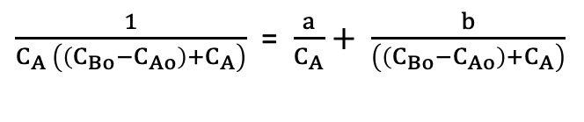
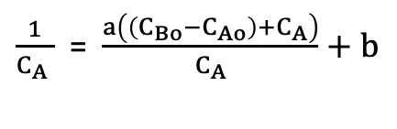
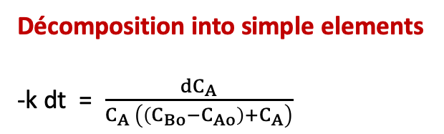

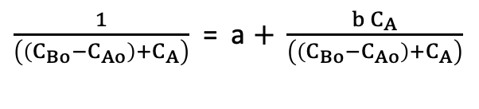
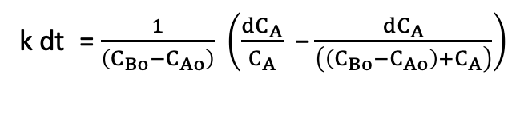
Ethyl acetate Hydrolysis
Décomposition into simple elements
-k dt = $\frac{{dC}_{A}}{C_{A} \left(\left(C_{Bo}−C_{Ao}\right)+C_{A}\right)}$
Je multiplie par $\left(\left(C_{Bo}−C_{Ao}\right)+C_{A}\right)$, ce qui donne:
$\frac{1}{C_{A} }$ = $\frac{a\left(\left(C_{Bo}−C_{Ao}\right)+C_{A}\right)}{C_{A}}+b$
$\frac{1}{C_{A} \left(\left(C_{Bo}−C_{Ao}\right)+C_{A}\right)}$ = $\frac{a}{C_{A}}+ \frac{b}{\left(\left(C_{Bo}−C_{Ao}\right)+C_{A}\right)}$
On prend C_{A} = - (C_{Bo}-C_{Ao}) alors: - $\frac{1}{\left(C_{Bo}−C_{Ao}\right)}$ = b
Je multiplie par C_{A}, ce qui donne:
$\frac{1}{\left(\left(C_{Bo}−C_{Ao}\right)+C_{A}\right)}$ = a $+ \frac{b C_{A}}{\left(\left(C_{Bo}−C_{Ao}\right)+C_{A}\right)}$
k dt = $\frac{1}{\left(C_{Bo}−C_{Ao}\right)} \left(\frac{dC_{A}}{C_{A}}\text{ −}\frac{{dC}_{A}}{\left(\left(C_{Bo}−C_{Ao}\right)+C_{A}\right)}\right)$
On prend C_{A} = 0 alors: $\frac{1}{\left(C_{Bo}−C_{Ao}\right)}$ = a

Slide 5
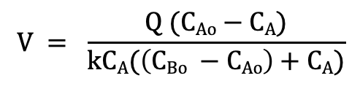
Ethyl acetate Hydrolysis
Mass balance on A in a continus stirred tank reactor
Q C_{Ao} - k C_{A} C_{B} V = Q C_{A}
Inlet flow Chemical Outlet flow
rate of A production of A rate of A
F_{Ao}, F_{Bo}
F_{A}, F_{B}, F_{p}
Desired reaction rate X = 0,9
Once the two solutions are mixed, the density is constant
C_{A} = C_{Ao} (1-X) = 0,1 C_{Ao}
A consumption = B consumption
C_{Ao} - C_{A} = C_{Bo} - C_{B}
$$V = \frac{Q (CAo−CA)}{kCA(\left(CBo −CAo\right)+CA)}$$
V = 348 l

Slide 6
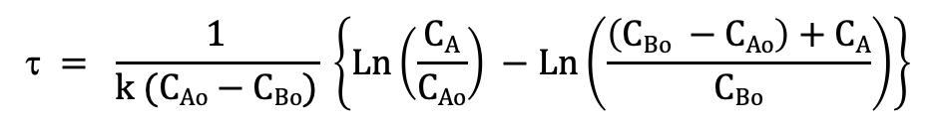
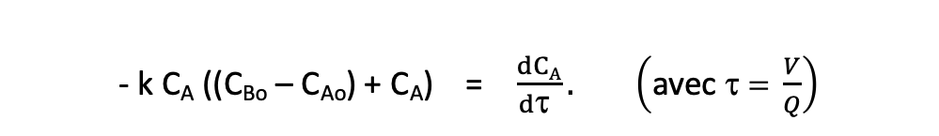
Ethyl acetate Hydrolysis
Mass balance on A in a plug flow reactor
F_{A} - r dV = F_{A} + dF_{A}
Q C_{A} - k C_{A} C_{B} dV = Q C_{A} + Q dC_{A}
Inlet flow Chemical Outlet flow
rate of A production of A rate of A
- k C_{A} ((C_{Bo} – C_{Ao}) + C_{A}) dV = Q dC_{A}
F_{A}
dV
F_{A} + dF_{A}
Desired reaction rate X = 0,9
Once the two solutions are mixed, the density is constant
C_{A} = C_{ao} (1-X) = 0,1 C_{Ao}
A consumption = B consumption
C_{Ao} - C_{A} = C_{Bo} - C_{B}
- k C_{A} ((C_{Bo} – C_{Ao}) + C_{A}) = $\frac{dCA}{d\text{t} }. \left(\text{avec} \text{t}\text{ = }\frac{V}{Q}\right)$
$$\text{t} = \frac{1}{k (CAo−CBo)} \left\{Ln\left(\frac{CA}{CAo}\right) −Ln\left(\frac{\left(CBo −CAo\right)+CA}{CBo}\right)\right\}$$
V = 53 l

